Slide 1

Security as a New Metric for Your Business, Product and Development Lifecycle
by Nazar Tymoshyk, SoftServe, Ph.D., CEH

Slide 2

OWASP Ukraine 2015 Security meetup у Львові
14 листопада 2015, субота, Львів, вул. Садова 2А
Тематика:
Безпека Веб і Мобільних аплікацій
Взлом REST і JavaScript базованих аплікацій
Розслідування взломів
Reverse-Engineering
Розвод, кідалово і маніпуляція свідомістю юзерів
Хмарна і безхмарна безпека
Фізичний взлом + Escape Quest
OWASP Chapter Lviv запрошує на останню зустріч групи OWASP Ukraine цього року. Проведіть чудові 2 дні у Львові з найкращими Security спеціалістами України.
Реєстрація у: https://goo.gl/5hdvPH
http://owasp-lviv.blogspot.com/
Львівка кава, кавярні і пиво, круте товариство, нові знайомства, воркшопи, знання на халяву – все це чекає на вас у нашому затишному місті!

Slide 3
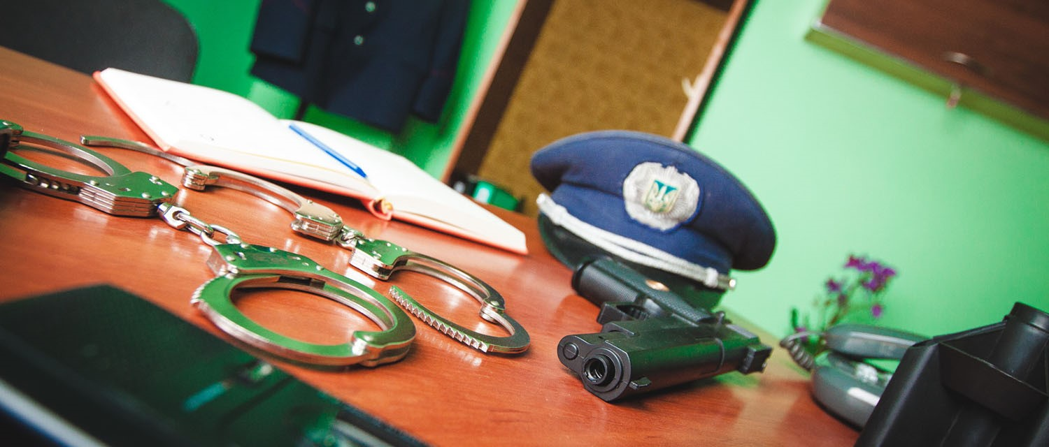

Physical Hacking Escape quest
OWASP Ukraine 2015 Lviv meetup, November 14, 2015
Industry Experts
Collaboration
Elite HACKERS
Competition
The most interesting Security event of Ukraine
Hands on Labs
Powered by

Slide 4















Security as a metric
Updated business model allow us to generate more revenue from same amount of opportunities
H1 2014
H1 2015
Total served: 24
Completed: 10
Internal: 3
Lost: 14
Win rate: 67%
Total served: 26
Completed: 12
Internal: 3
Lost: 14
Win rate: 46%

Slide 5

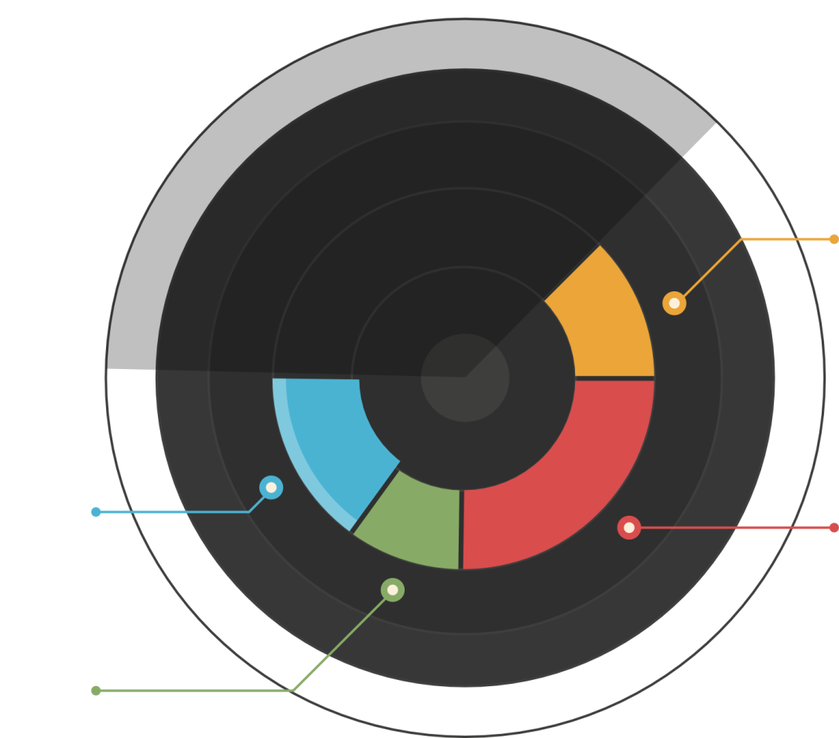
Agenda
Your imaginary
Business
Questions
Products
Developers

Slide 6
BUSINESS

Slide 7
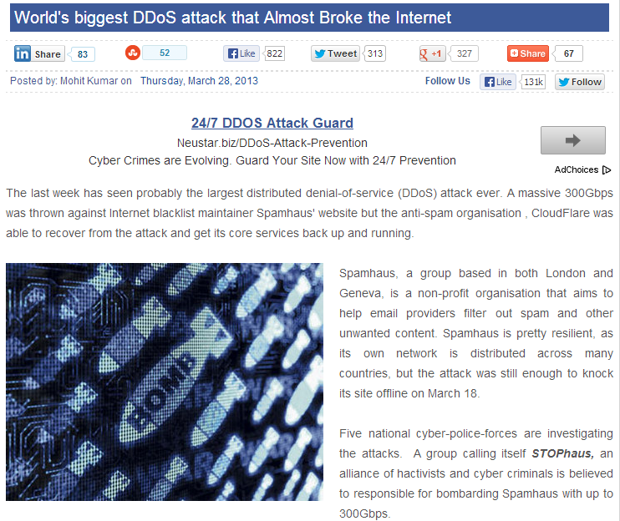
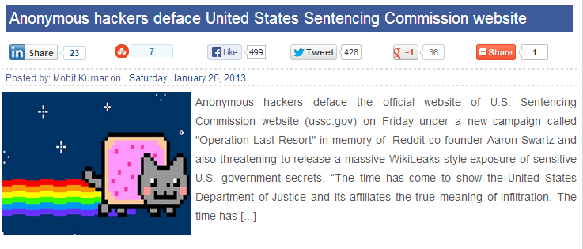
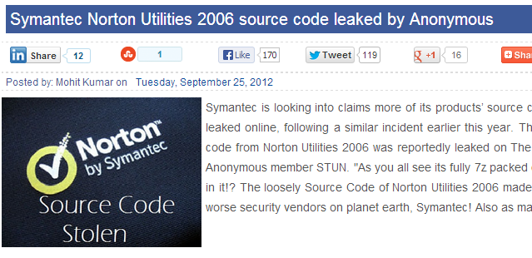
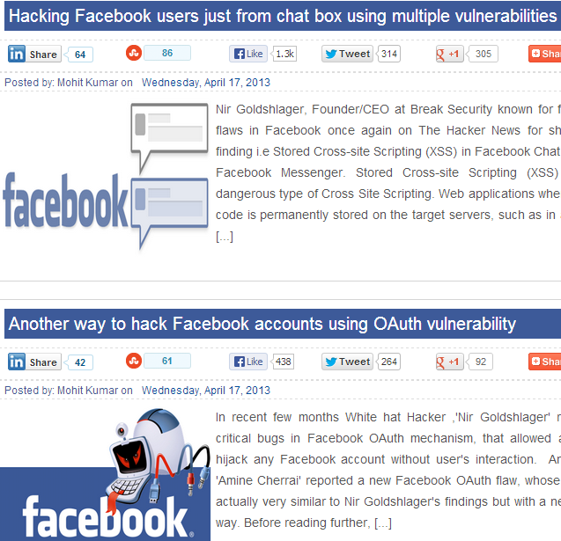
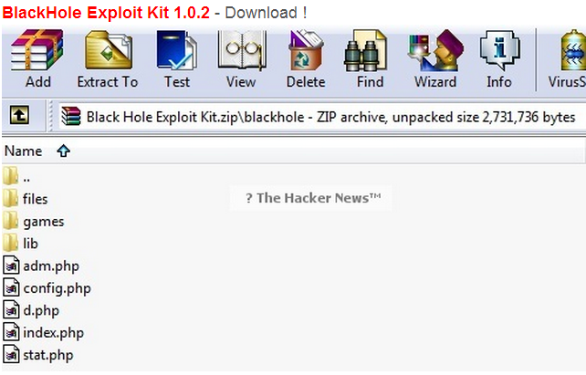
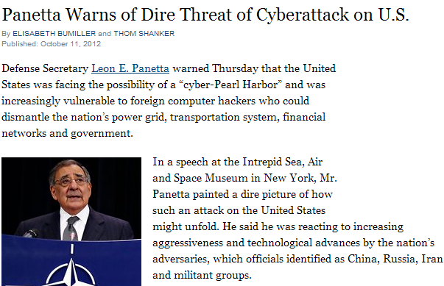
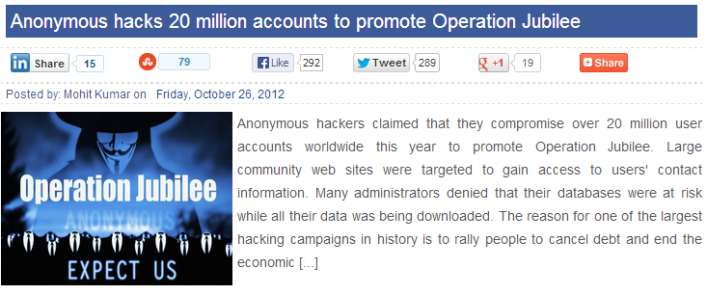
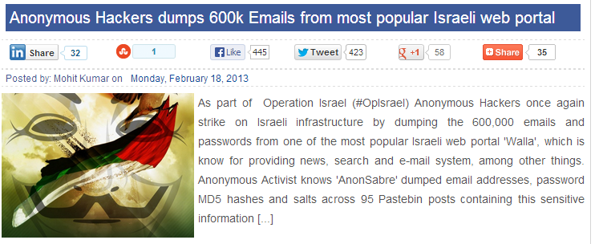
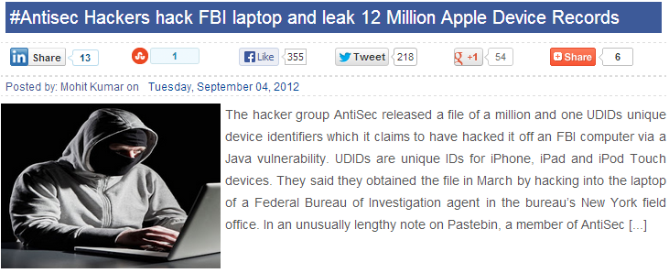
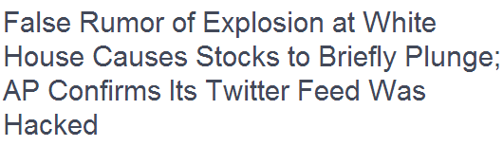
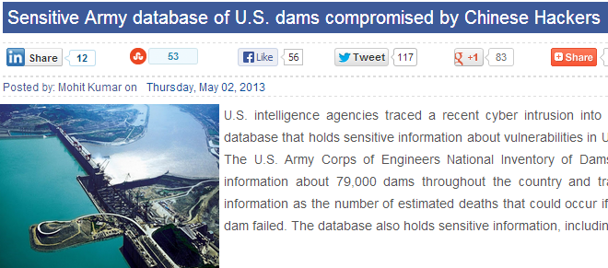
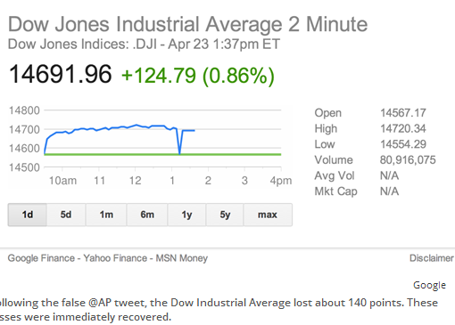
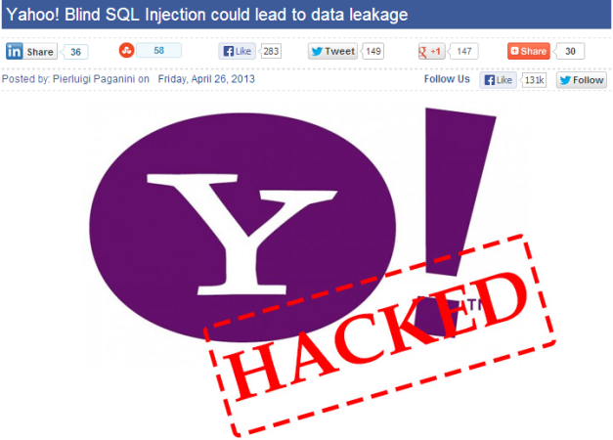
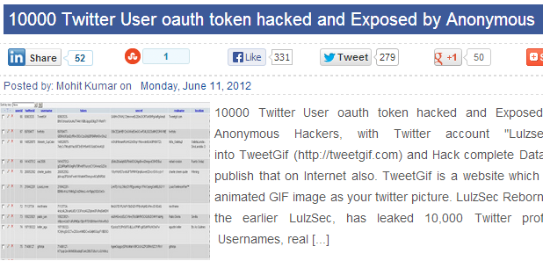
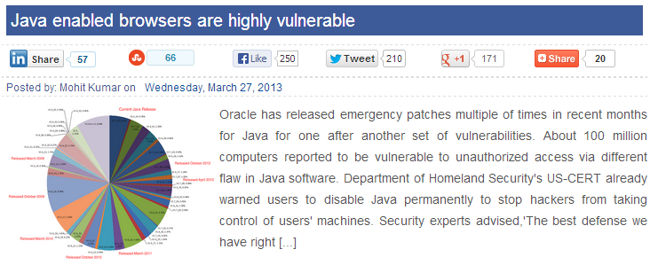
A rough year in 2012

Slide 8
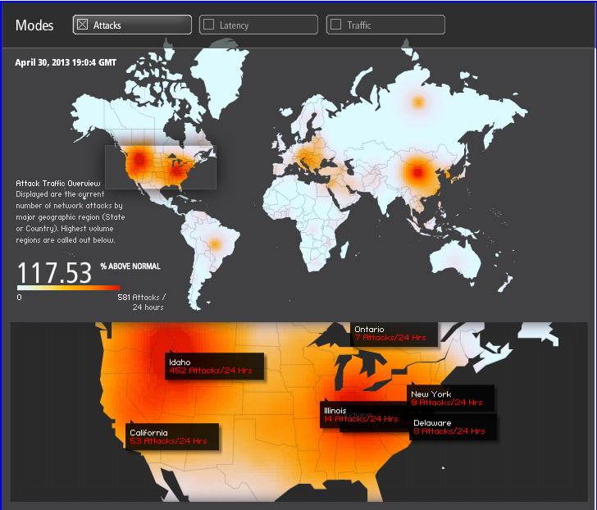
A more challenging year - 2013
Akamai reports that 2013 attack traffic is averaging over 86% above normal.
This report shows April 30 attack traffic is 117.53% higher than the 42% increase seen in 2012

Slide 9
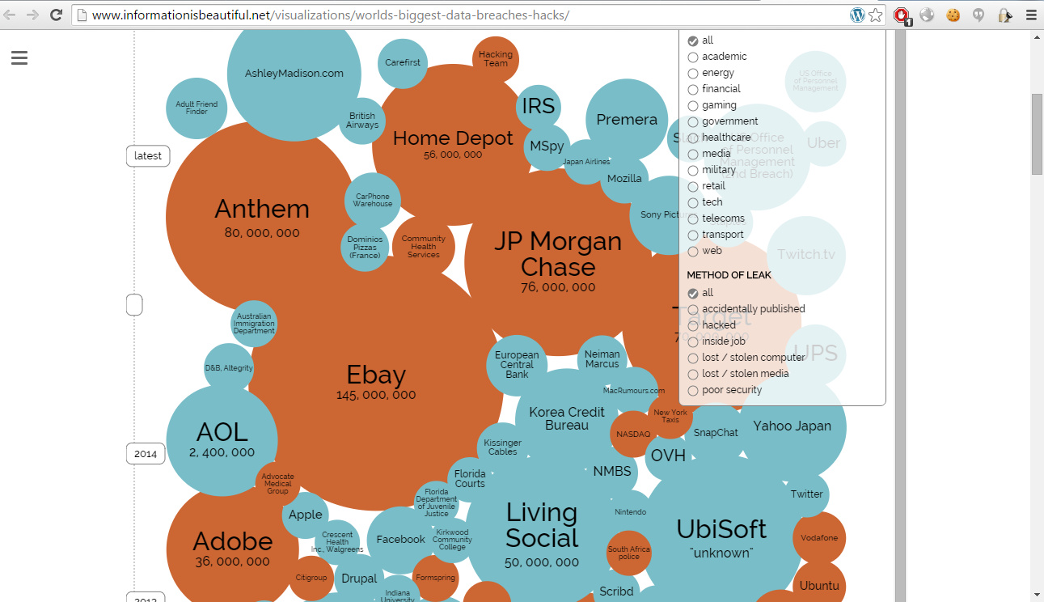
http://www.informationisbeautiful.net/visualizations/worlds-biggest-data-breaches-hacks/

Slide 10
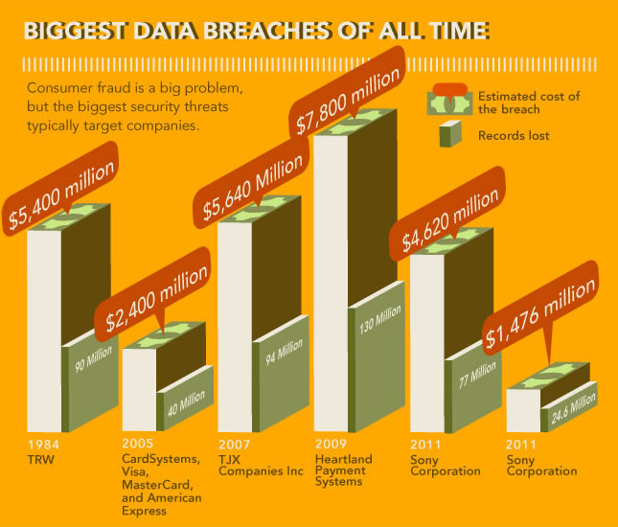

Slide 11
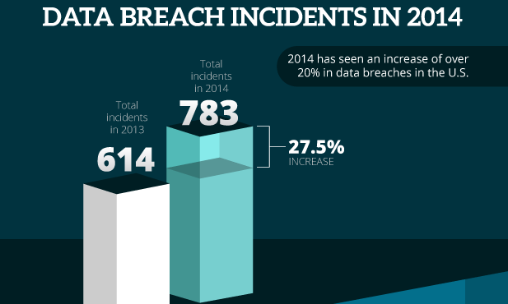

Slide 12

WHY your clients NEED Security
Customer requirement
Government
Regulation
Business availability
Previous bad experience
Industry
Compliance
Statistic of Breaches
Capitalization

Slide 13

Consequences of Security FAILURE
Money
Customers
Trust
Time
to recover
Reputation
Data
stolen
Penalties
for incident

Slide 14
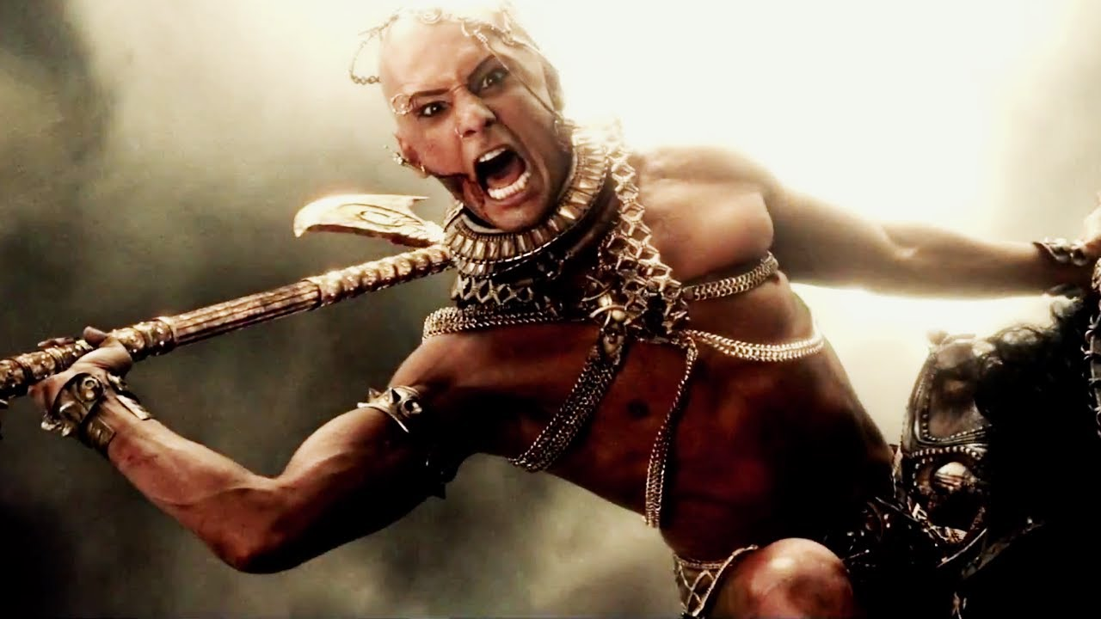
We were hacked because of YOU!
Your
very sad
client
Super user
Penalty tool
Subscriptions

Slide 15

If your Cloud server is hacked….

Slide 16
PRODUCT

Slide 17
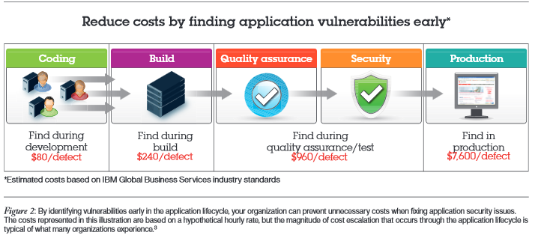
Simple ROI of Product security

Slide 18

Connected Cars are part of
smart phones
smart TVs
smart cars
smart watches
smart houses
smart fridges ????

Slide 19
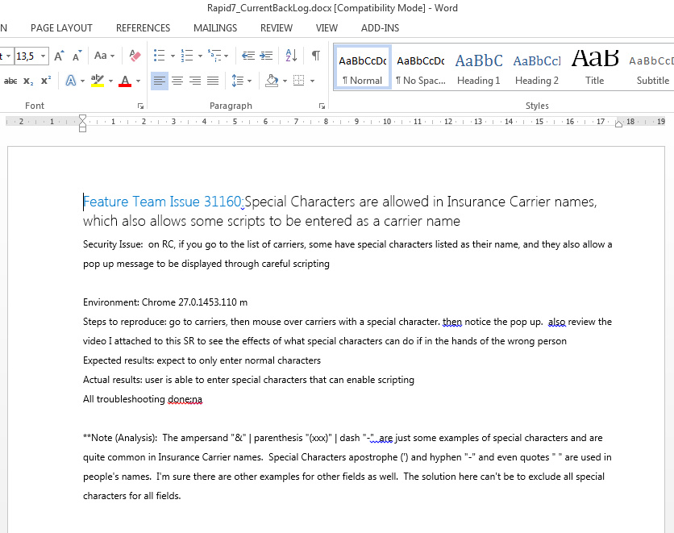
Typical Security Report delivered by competitor

Slide 20
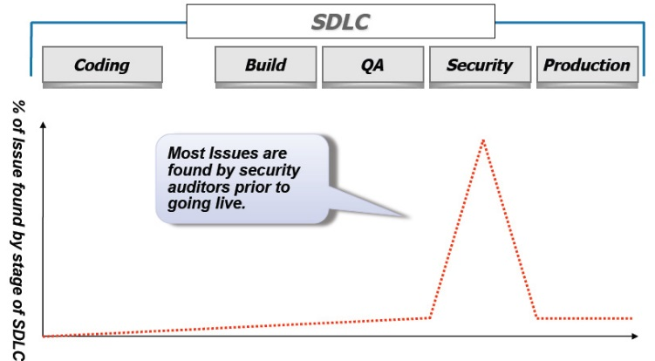
How security is linked to development
3rd party or internal audit
Tone of security defects
BACK to re-Coding, re-Building, re-Testing, re-Auditing
Than start process of re-Coding, re-Building, re-Testing, re-Auditing

Slide 21
Generic Approach for Security
Secure SDLC
Proactive Approach
Reactive Approach
security requirements / risk and threat analysis
coding guidelines /code reviews/ static analysis
security testing / dynamic analysis
vulnerability scanning / WAF
Design
Build
Test
Production

Slide 22
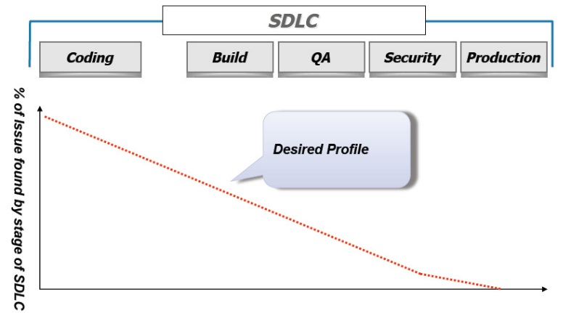
How it should look like
Minimize the costs of the Security related issues
Avoid repetitive security issues
Avoid inconsistent level of the security
Determine activities that pay back faster during current state of the project
With proper Security Program number of security defects should decrease from phase to phase
Secure
Coding
trainings
Automated
security
Tests
CI
integrated
Manual
Security/penetration
Testing
Regular
Vulnerability
Scans
OWASP methodology

Slide 23
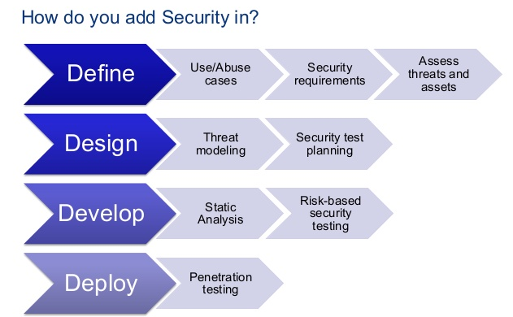

Slide 24
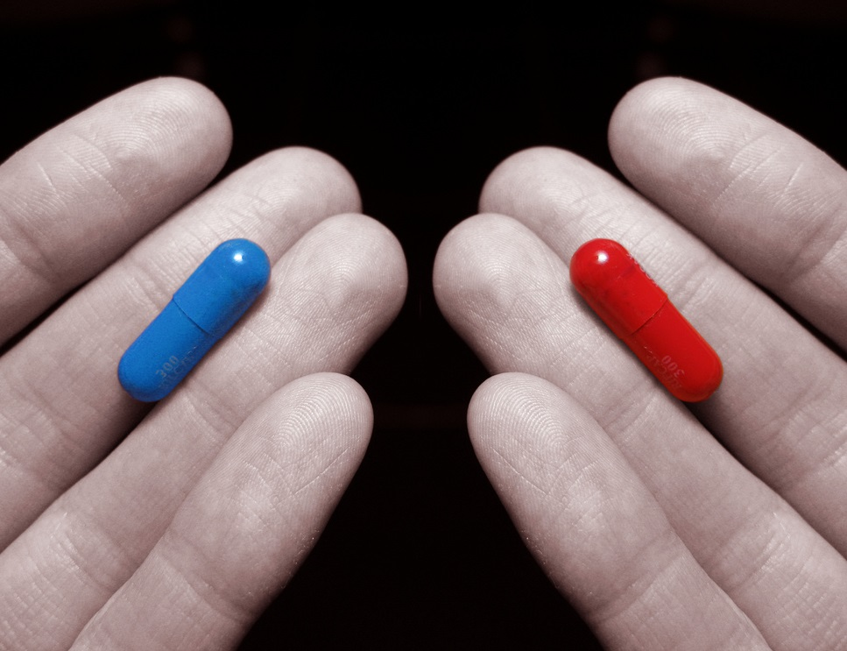
To do Security or not to Do
Remember I'm offering you the truth. Nothing More.

Slide 25

QA Engineer
VS.
Security expert
In functional and performance testing, the expected results are documented before the test begins, and the quality assurance team looks at how well the expected results match the actual results
In security testing, security analysts team is concerned only with unexpected results and testing for the unknown and looking for weaknesses. They are EXPERTS.

Slide 26



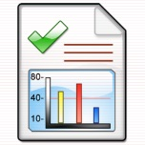








Our app code need to be verified for Security
Scenario 1.
PM worried about security on project.
Code micro-assessment.
Reporting
for 2 security experts
Scan sources with Tools
Filtering False Positive
Compile report
Review architecture
Dynamic test
Rate risks
PM
Report with findings
Request
App
verification
Security
Center of Excellence
Delivery Director/PM
Good boys!
Fix it!
Non compliant?
PM and SoftServe
Demonstrate excellence
Explain security defect and severity
Fix identified security defects
Train developers and QA
Transfer checklists and guides
How to present to client
and earn more $$$ ?
Competitive advantage
Great Achievement
Re-check
Monitor
Next page
Notes:
майндмапа дала зрозуміти які сценарії і як використовувати щоб приносити бенефіти на існуючих проектах
сценарії
бабло
інволвмент
виконавці
часові фрейми
усування конкурентів
вирішення ряду бізнес проблем наприклад усунення конкурентів

Slide 27



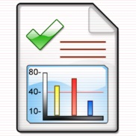
Oh Rashid,
We have found some security issues with your legacy code
Who wrote it?
Indian team. Our security experts can perform comprehensive Security Assessment
1
2
Only $XX.XXX for Security Assessment
Ok, do it. How much should it cost?
And then our dev team will fix identified defects as it put other projects under risk
Deal!
Do it ASAP.
4
3

Slide 28
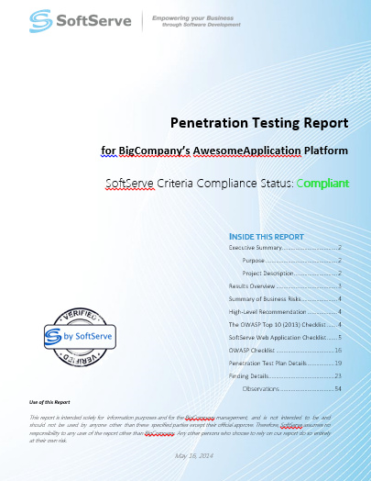
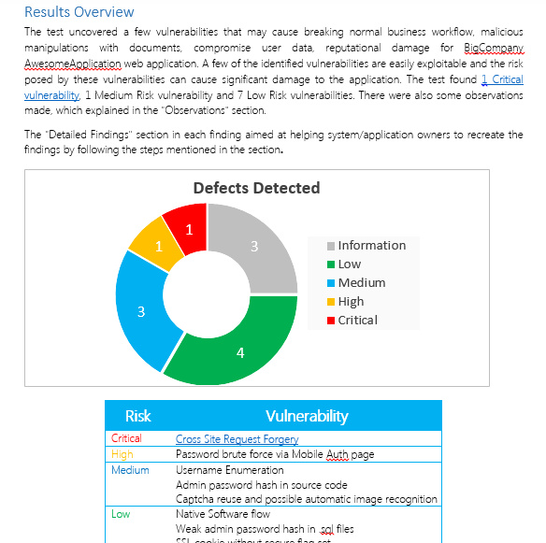
Report sample

Slide 29
DEVELOPMENT

Slide 30

Risks are for managers, not developers

Slide 31
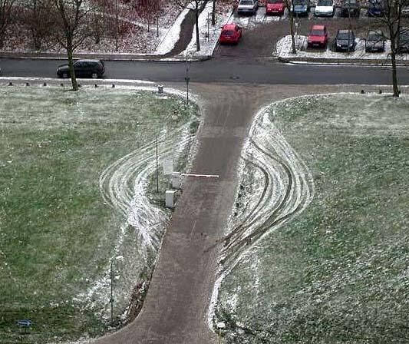
PEOPLE always bypass restriction if possible
Keep in mind this when
you design security

Slide 32

Developer & Security
Focus on functional requirements
Know about:
OWASP Top 10
1 threat (DEADLINE fail)
Implement Requirements as they can
Testing it’s for QA job
«I know when I’m writing code I’m not
thinking about evil, I’m just trying to think about functionality» (с) Scott Hanselman

Slide 33
Why code analysis do not resolve a problem?
Many of the CWE vulnerability types, are design issues, or business logic issues.
Application security testing tools are being sold as a solution to the problem of insecure software.

Slide 34

Mobile banking app from Pakistan

Slide 35
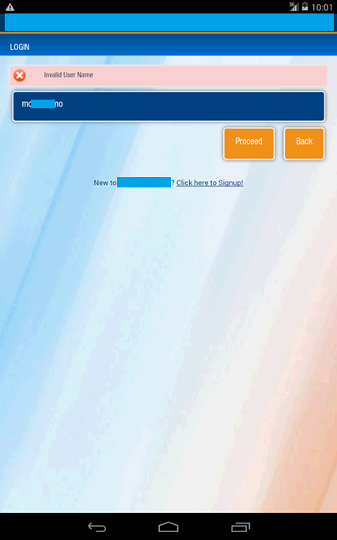
What is wrong?

Slide 36
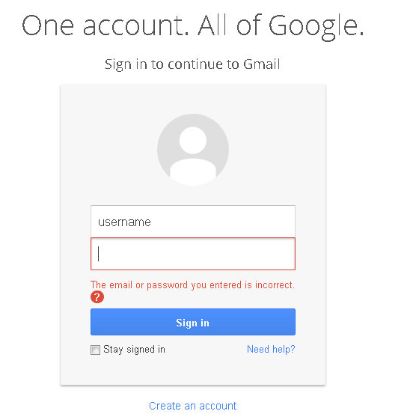
Recommended error messages by OWASP
Incorrect Response Examples
"Login for User foo: invalid password"
"Login failed, invalid user ID"
"Login failed; account disabled"
"Login failed; this user is not active"
Correct Response Example
"Login failed; Invalid userID or password"
https://www.owasp.org/index.php/Authentication_Cheat_Sheet

Slide 37
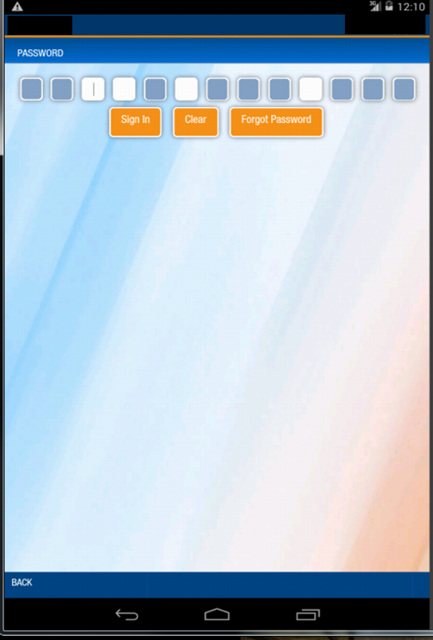
What is wrong on next stage of Login process?

Slide 38
Critical Business Logic bypass
There was possibility to get personal info (promo code, email, password etc.) of subscription which is not related to currently logged User using

Slide 39
Critical Business Logic bypass
There was possibility to make changes to personal info of subscription (email, password, name e.g.) using User.updateSubscription method even in case appropriate user is not logged in

Slide 40
Critical Business Logic bypass
There is possibility to convert any standalone subscriptions to managed no matter whether appropriate user is logged in or not using User.setSubscriptionToManaged function (you can make any user to pay for paid features of your subscriptions)

Slide 41
Critical Business Logic bypass
There was possibility to delete subscriptions/credit card which are not related to currently logged user using User.deleteSubscription/deleteCredit Card function

Slide 42
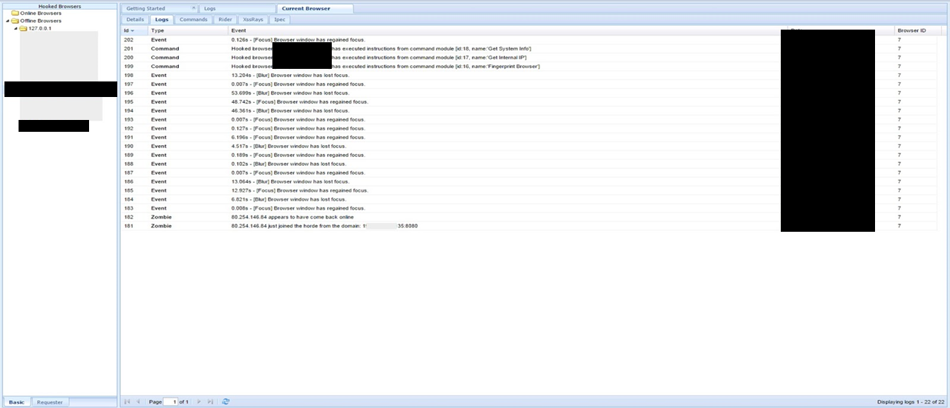
Browser exploitation framework

Slide 43
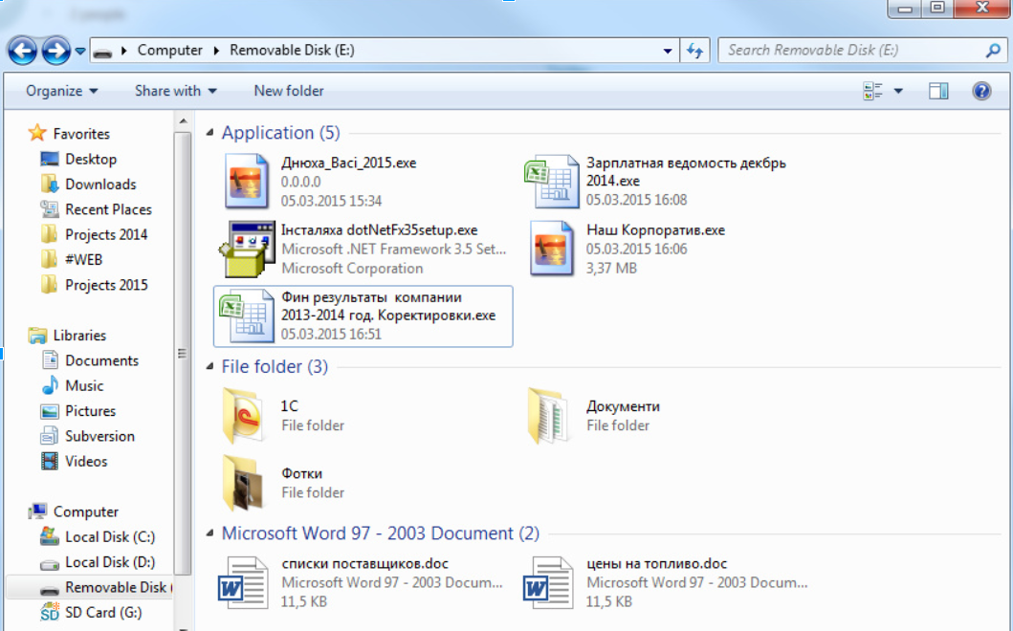
Social Engineering

Slide 44
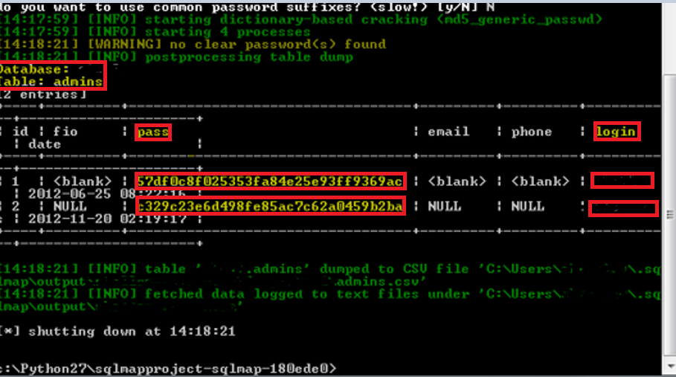
SQL-Injections to win a Trip
Dumped admin password hashes

Slide 45
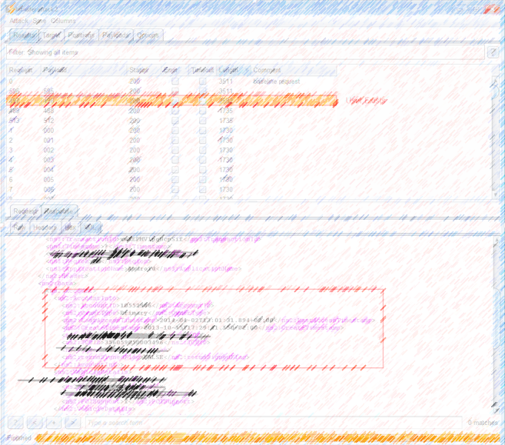
Broken Session management
Simple SOAP request fuzzing allow collecting information about existent system users, their emails, VIN, Last access time, user ID and other confidential, user/car related information

Slide 46
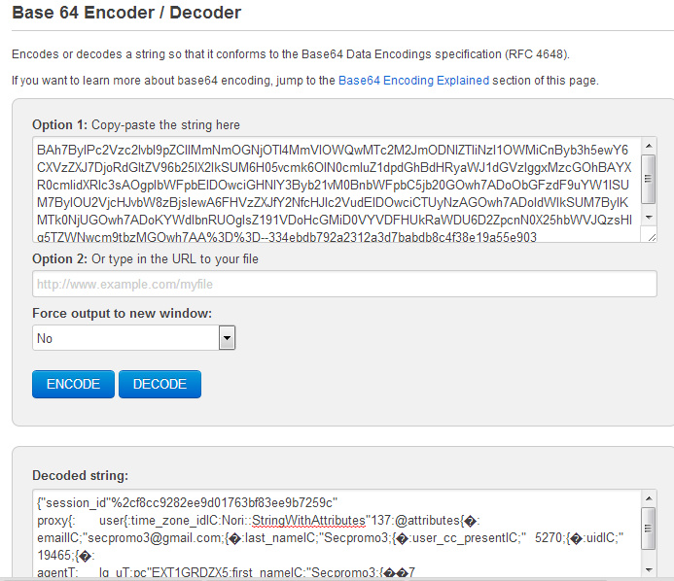
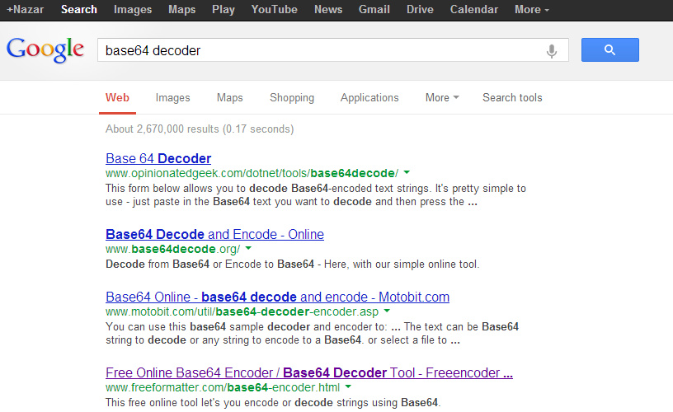
Why so simple?

Slide 47
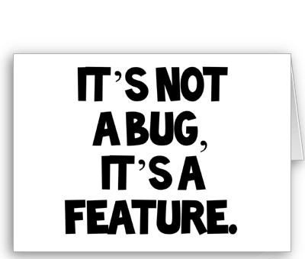

Story about Hybrid Mobile Development in India

Slide 48
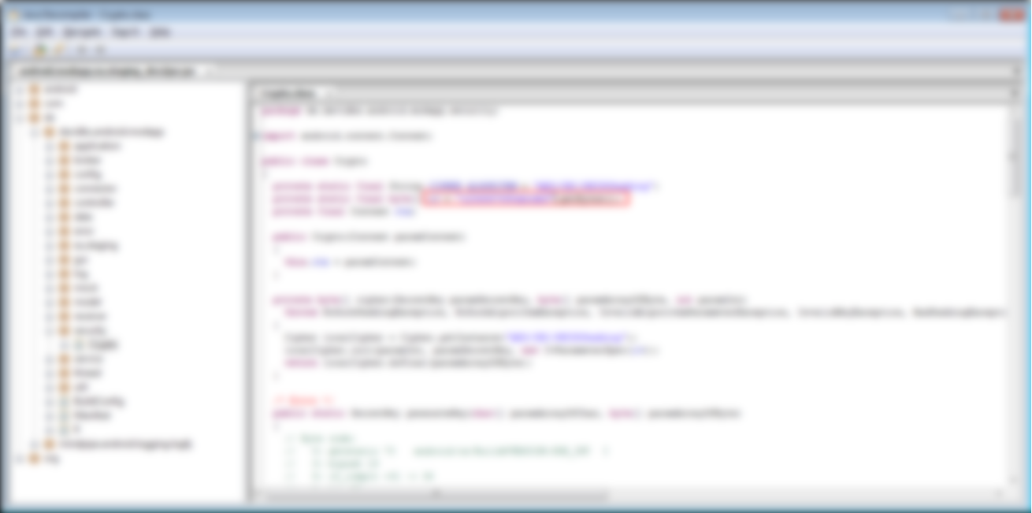
Reversing Java/iOS application this app feature
Reversing Java / iOS application this app feature

Slide 49
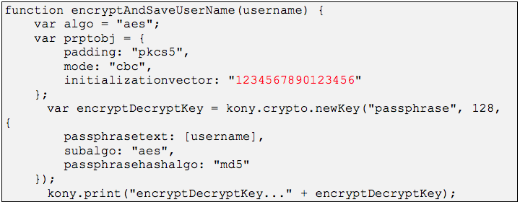
Weak Cryptography
Was cleaned up by Vendor Team
v

Slide 50
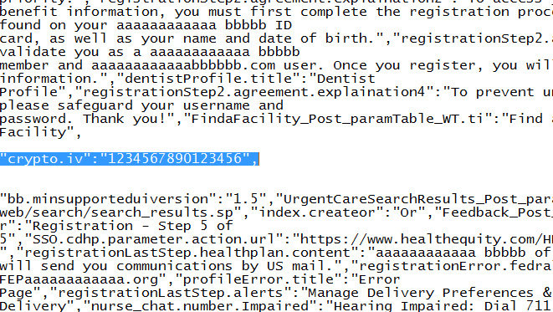
Removed code appears again in AppStore app
Appear Again in App from AppStore
v

Slide 51
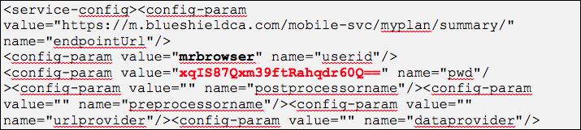
Hardcoded credentials
Severity: Critical (C )/P1
Business impact: Medium (M)/P3
v
v
v

Slide 52
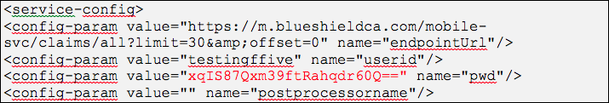
Backend security
Severity: Critical (C )/P1
Business impact: Critical (C )/P1
v
v

Slide 53
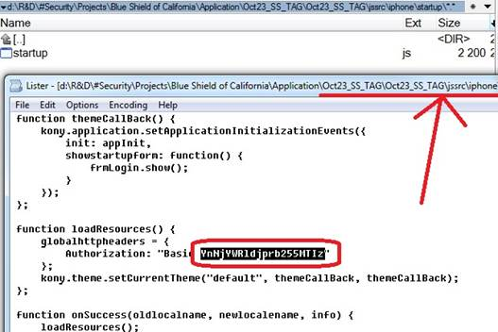
Weak passwords
Severity: Critical (C )/P1
Business impact: Critical (C )/P1

Slide 54
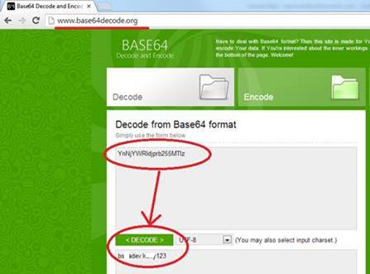
Developer team facepalm
v

Slide 55

Encryption password after AppStore release
v
v
v
v
v
v

Slide 56

Sensitive File Artifacts
Severity: Low (L)/P4.
Business impact: No business impact
v
v
v

Slide 57

Financial Institution
All Apps are considered safe until proven guilty by a security review

Slide 58


SENSITIVE CLIENT INFORMATION
AS A CONSEQUENCE – CUSTOMERS TRUST COULD BE LOST.

Slide 59

Customers database dump

Slide 60



defaults and sample files

Slide 61


Forgotten Files on server

Slide 62

Upload Java shell and take server under control

Slide 63

Are your product Popular?
You are Next Target

Slide 64

How to PROTECT?
Right Security Requirements
Threat Modelling
Security Trainings
Security Frameworks
Code Scan and Review
OWASP.org
Dedicated Security Expert
Penetration Testing

Slide 65


Add Security into your PROCESS

Slide 66


Security

Slide 67

Thank you
Feedback & Questions
Contact me:
skype: root_nt
email: root.nt@gmail.com
Join OWASP:
http://owasp-lviv.blogspot.com/

Slide 68

Home Work

